Slide 1

PROTEIN THREADING
APARNA PATIL KOSE
LECTURER
DEPT OF BIOINFORMATICS

Slide 2
CONTENTS
Background: Protein structure basics
Protein Structure Prediction
Protein threading
Basic strategy
Major Components
Approaches
Computational complexity
Performance of protein threading systems
Limitations

Slide 3
Protein Structure Basics
Primary, secondary, tertiary structure

Slide 4
Protein Structure Prediction Methods
Three main categories of protein structure prediction methods:
Ab initio methods
Fold recognition methods
Comparative modeling methods

Slide 5
Protein Modeling Methods
Simulation based methods:
Ab initio methods:
solution of a protein folding problem
search in conformational space
Energy-based methods: energy minimization molecular simulation
•
Knowledge-based methods:
Homology modeling
Fold recognition

Slide 6
Protein Structure Prediction
Threading/Fold recognition
Ab initio
In both methods, establishing sequence
↔ structure relationship is important
Input from people trained in statistics, pattern recognition and related areas of computer science is very critical

Slide 7
BASIS OF THREADING
It is estimated there are only around 1000 to 10 000 stable folds in nature
Irrespective of the amino acid sequence, a protein has to adopt one of these folds

Slide 8
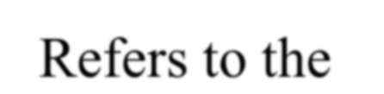
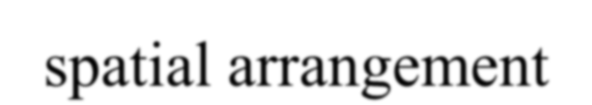
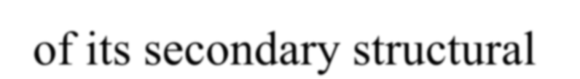
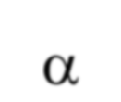
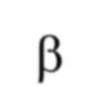
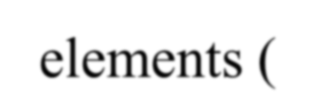
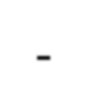
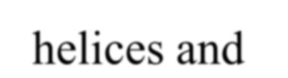
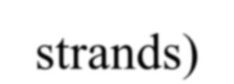
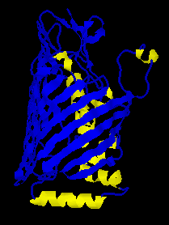
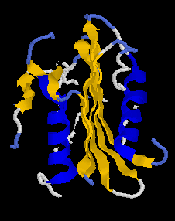
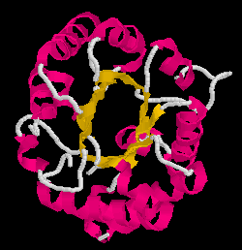
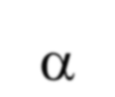



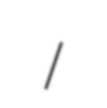
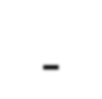

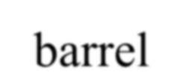
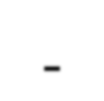

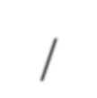
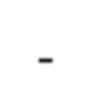
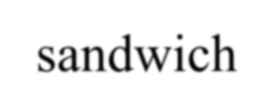
PROTEIN FOLD
Refers to the spatial arrangement of its secondary structural elements (α-helices and β-strands)
1l45.pdb
4bcl.pdb
1mbl.pdb
α/β-barrel
β-barrel
α/β-sandwich

Slide 9
PROTEIN FOLDING
Protein folding = searching for a conformation having minimum energy
Thus, fold recognition is essentially finding the best fit of a sequence to a set of candidate folds

Slide 10
Factors in protein folding
hydrophobic effects
electrostatic charges in residues
hydrogen bonding
chaperonins, ribosomes

Slide 11
THREADING
A method for predicting the structure or recognizing a common fold in proteins having essentially no sequence homology, to any protein in PDB.
Picks up where homology modeling leaves off.
Unknown sequence is “folded” in a number of known structures

Slide 12
Why is it called threading ?
Superficially resembles the method used to thread a thin tube
down or through a pipe system
Threading a specific sequence through all known folds
For each fold estimate the probability that the sequence can
have that fold
It works by using statistical knowledge of the relationship between the structures deposited in the PDB and the sequence of the protein which one wishes to model.

Slide 13
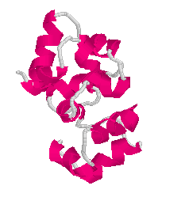
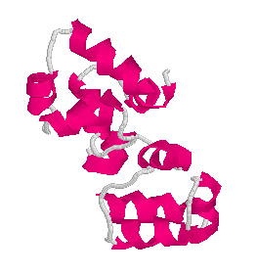
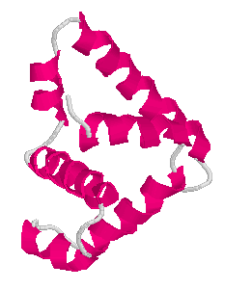
Fold recognition (Threading)
The sequence:
+
Known protein folds
M | A | A | G | Y | A | V | L | S
structural model

Slide 14
Limited to generating very approximate models/folds (5 Aº RMSD)
As each sequence feds, the fit is evaluated. For best fits with given template pipe.
Possible to assess protein sequences that are compatible with given background fold.
Evaluation carried out using: Empirical energy terms &
Packaging efficiency measurements.

Slide 15
BASIC IDEA of Threading:
The Target (Protein) sequence is threaded through the
backbone structures
of a collection of templates
& a „goodness of fit‟ score
(called Fold library)
calculated for each sequence-structure alignment.
7/01/2015
15

Slide 16

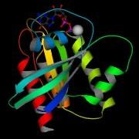
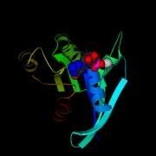
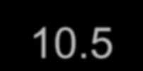


ATTWV....PRKSCT
.........
.
10.5
>
..........
5.2
SELECTED HIT

Slide 17











Sequence
Pred. Sec. Struc. Pred. accesibility
ATTWV....PRKSCT HHHHH....CCBBBB
eeebb....eeebeb
..........
Sequence Obs SS Obs Acc.
GGTV....ATTW
BBBB....CCHH
EEBE.....BBEB
...........
...........
...........
ATTVL....FFRK
HHHB.....CBCB
BBEBB....EBBE

Slide 18
Threading: BASIC STRATEGY
Query
(Target seq)
dhgakdflsdfjaslfkjsdlfjsdfjasd
Library of folds
Scoring & selection
Goodness of fit: Spatial
Interactions
Template
Sequence

Slide 19


Protein Threading
Conserved Core Segments
K L
J
I
Protein A
Conserved Core Segments
Protein B

Slide 20
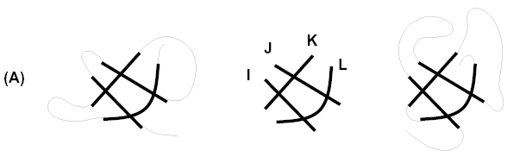
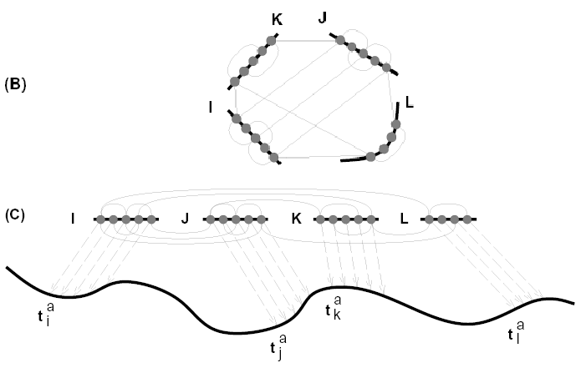
Two structurally similar proteins
Spatial adjacencies (interactions)
Possible threading with a sequence

Slide 21
INPUT/OUTPUT of Threading
T H R E A D I N G
Core segments C[1..m]
Amino acid sequence a[1..n]
g(…)
Pairwise amino acid scoring function

Slide 22











Input:
sequence
H bond donor
H bond acceptor Glycin Hydrophobic
Library of folds of known proteins

Slide 23
Considerations (From Sequence)
Amino acid type
Position on sequence

Slide 24
Four major components of Threading:
A LIBRARY of protein folds (templates)
A SCORING FUNCTION to measure the fitness of a sequence -> structure alignment

Slide 25
A SEARCH TECHNIQUE for finding the best
alignment between a fixed sequence and structure
A means of choosing the BEST FOLD from among the best scoring alignments of a sequence to all possible folds

Slide 26
TWO APPROACHES
DBM
Distance based Method
Three Dimensional threading
PBM Prediction based Method Two Dimensional threading

Slide 27
DBM
1980s, rediscovered-1990s
Uses Distance based or Profile based Energy functions
Powerful approach
Predicts structure of unknown proteins
Also used for evaluation of Structural Quality of known proteins
RMSD > 3 A° (Low quality folds)

Slide 28
PBM
1980s, rediscovered- mid 1990s
Uses secondary structure as the primary evaluation
criterion
Strategy: Secondary structure more conserved than primary structure/ sequence
Has many advantages over 3D threading:
10-100 times faster
Comparable & better results
7/01/2015
28

Slide 29
Scoring Schemes for Sequence->Structure Alignments
The scoring scheme for a particular threading of a sequence onto a structure measures the degree to which:

Slide 30
Environmental preferences are satisfied:
Different amino acid types prefer different
environments e.g.
Structural preferences: in helix
in sheet
not exposed to solvent
Pair wise interactions with neighboring amino acids

Slide 31
Formal Statement of the Protein Threading Problem
C is a protein core having m segments Ci representing a
set of contiguous amino acids Let ci be the length of Ci
Sequence a = a1a2…an of amino acids

Slide 32
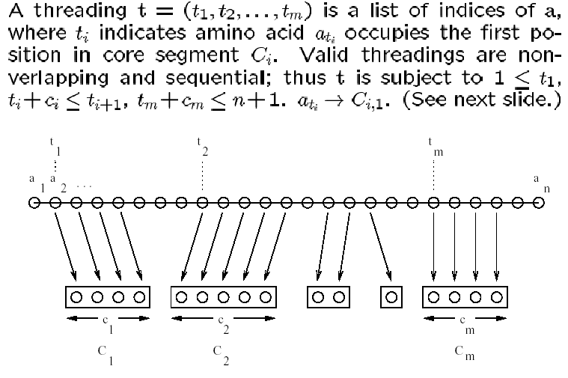
32

Slide 33
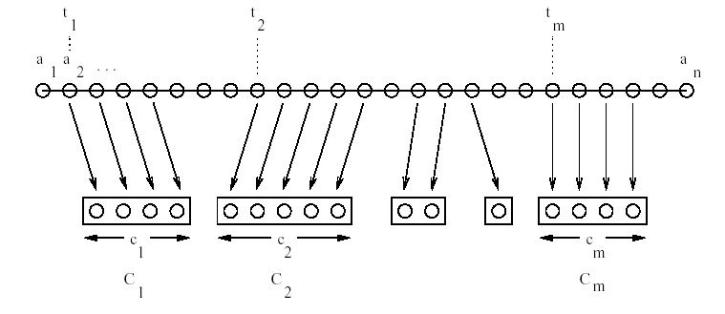
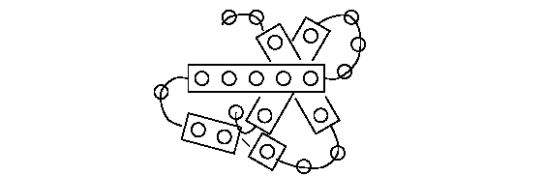
Vrus ali P, Lectu
oinform ics

Slide 34
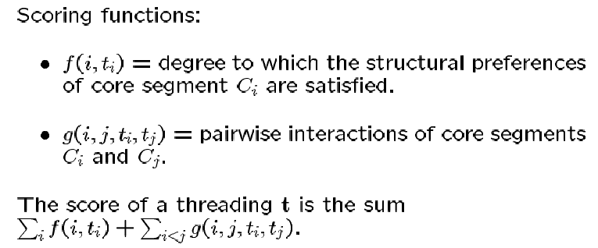

Slide 35
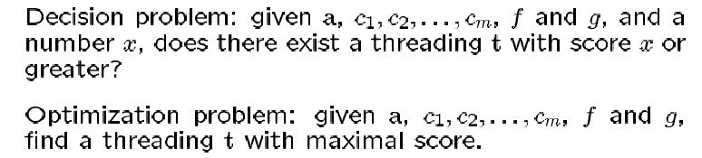

Slide 36
COMPUTATIONAL COMPLEXITY of
Finding an Optimal Alignment
The complexity of the protein threading problem
depends on whether:
Variable-length gaps are allowed in alignments
The scoring function for an alignment incorporates pairwise interactions between amino acids

Slide 37
Thus all protein threading approaches can be divided into four groups:
no variable length gaps allowed
no pairwise interactions considered in scoring function
no optimal solution guarantee 4 exponential runtime

Slide 38
PERFORMANCE
of Protein Threading Systems
CASP1(1994) CASP2(1996) CASP3(1998):
Critical Assessment of Structure Prediction meetings protein threading methods have consistently been the winners.
success depends on structural similarity of target to known structures
successful even when target sequence and library sequence have low homology

Slide 39
The Protein Folding or Threading Problem
Given a protein‟s amino acid sequence what is its
tertiary structure
The protein folding problem is hard
To find the best way to „mount‟ the residue sequence of one protein on a known structure taken from another protein.
39

Slide 40
LIMITATIONS
Less than 30% of the predicted first hits are true remote homologues (PredictProtein).
Generate approximate models
Statistical problems
Definition of neighbor and/or pairwise contact environments

Slide 41
Much room for IMPROVEMENT in all areas of protein threading e.g.:
Algorithms for searching the threading space
Reliable biologically accurate scoring functions

Slide 42
RESOURCES
3DPSSM
Integrated system, does its own MSA and secondary
structure predictions and then threading
TOPITS
Heuristic Threader, part of larger structure prediction
system
GenThreader
Similar to 3DPSSM

Slide 43
FUGUE
SAMt99
EVA website
PDB BLAST
Metaservers (Multiple combined predictions)

Slide 44
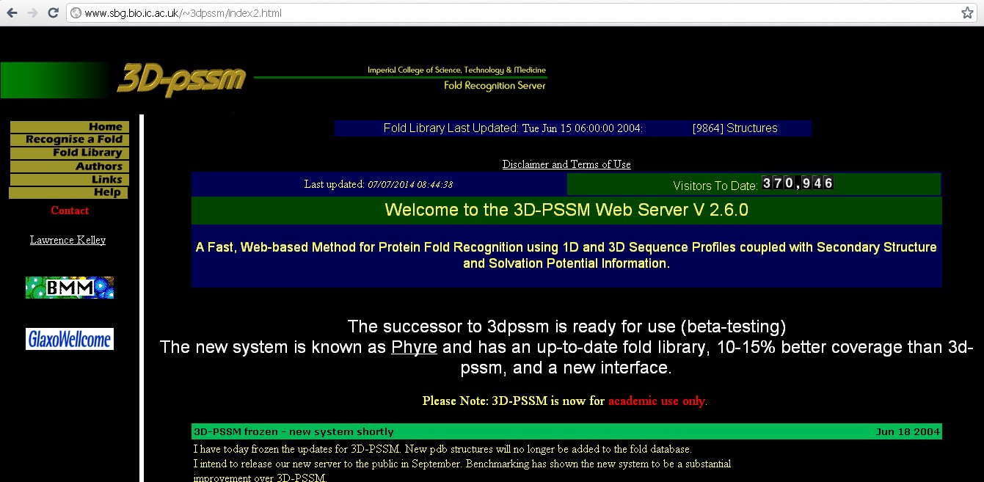

Slide 45
